Slide 1



A New Age of Fabrication
Omar Choudhry
Oxmedica-Mawhiba Summer Tech Summit 2024
Notes:
السلام عليكم ورحمة الله وبركاته
بِسْمِ اللَّهِ الرَّحْمَٰنِ الرَّحِيمِ
اِنَّ الْحَمْدُ لِلَّهِ نَحْمَدُهُ وَنَسْتَعِينُهُ وَنَسْتَغْفِرُهُ
وَنَعُوذُ بِاللَّهِ مِنْ شُرُورِ أَنْفُسِنَا وَمِنْ سَيِّئَاتِ أَعْمَالِنَا
مَنْ يَهْدِهِ اللَّهُ فَلَا مُضِلَّ لَهُ
وَمَنْ يُضْلِلْ فَلَا هَادِيَ لَهُ
وَأَشْهَدُ أَنْ لَا إِلَهَ إِلَّا اللَّهُ وَحْدَهُ لَا شَرِيكَ لَهُ
وَأَشْهَدُ أَنَّ مُحَمَّدًا عَبْدُهُ وَرَسُولُهُ
يَا أَيُّهَا الَّذِينَ آمَنُوا اتَّقُوا اللَّهَ حَقَّ تُقَاتِهِ
وَلَا تَمُوتُنَّ إِلَّا وَأَنْتُمْ مُسْلِمُونَ
يَـٰٓأَيُّهَا ٱلنَّاسُ ٱتَّقُوا۟ رَبَّكُمُ ٱلَّذِى خَلَقَكُم مِّن نَّفْسٍۢ وَٰحِدَةٍۢ
وَخَلَقَ مِنْهَا زَوْجَهَا وَبَثَّ مِنْهُمَا رِجَالًۭا كَثِيرًۭا وَنِسَآءًۭ ۚ
وَٱتَّقُوا۟ ٱللَّهَ ٱلَّذِى تَسَآءَلُونَ بِهِۦ وَٱلْأَرْحَامَ ۚ
إِنَّ ٱللَّهَ كَانَ عَلَيْكُمْ رَقِيبًۭا
يَـٰٓأَيُّهَا ٱلَّذِينَ ءَامَنُوا۟ ٱتَّقُوا۟ ٱللَّهَ وَقُولُوا۟ قَوْلًۭا سَدِيدًۭا
يُصْلِحْ لَكُمْ أَعْمَـٰلَكُمْ
وَيَغْفِرْ لَكُمْ ذُنُوبَكُمْ ۗ
وَمَن يُطِعِ ٱللَّهَ وَرَسُولَهُۥ
فَقَدْ فَازَ فَوْزًا عَظِيمًا
إِنَّ أَصْدَقَ الْحَدِيثِ كِتَابُ اللَّهِ
وَأَحْسَنَ الْهَدْيِ هَدْيُ مُحَمَّدٍ صَلَّى اللَّهُ عَلَيْهِ وَسَلَّمَ
وَشَرُّ الْأُمُورِ مُحْدَثَاتُهَا
وَكُلُّ مُحْدَثَةٍ بِدْعَةٌ
وَكُلُّ بِدْعَةٍ ضَلَالَةٌ
وَكُلُّ ضَلَالَةٍ فِي النَّارِ
Thumma ’Amma-Ba’du
My name is Omar and Bi-Fadli-Allahi-Ta’alaa I am delighted to welcome you all to the Oxmedica-Mawhiba Tech Summit 2024 in Riyadh, Fi المملكة العربية السعودية.
To open the summit, I would like to discuss a pressing issue in this digital era – ‘A New Age Of Fabrication.’
إن شاء الله We'll explore how AI is reshaping our reality.

Slide 2
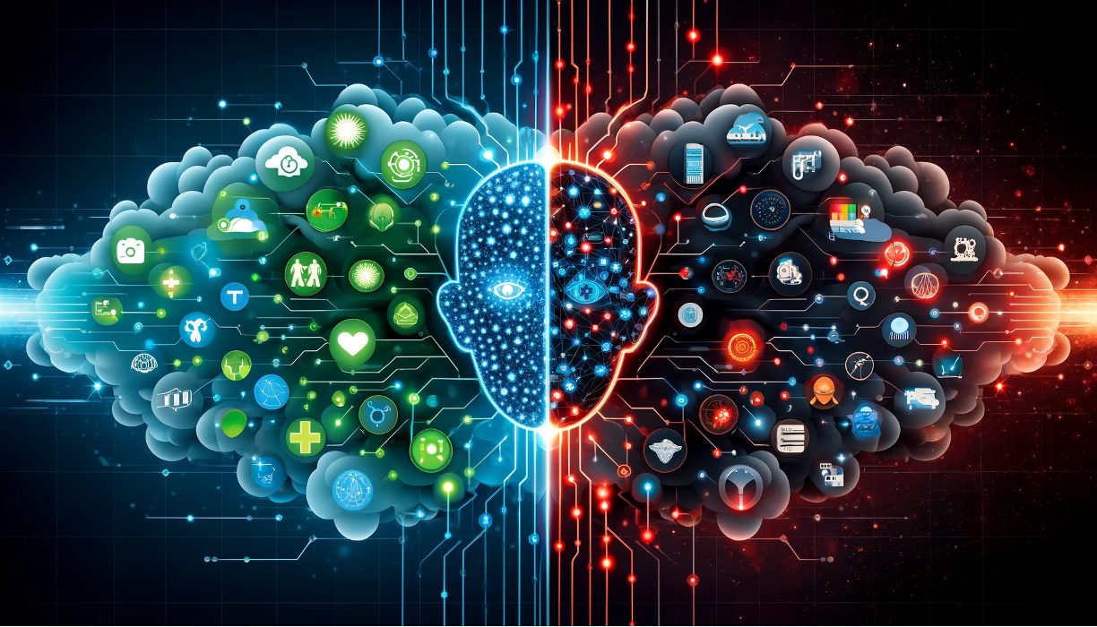
A Double-Edged Sword
Notes:
AI is a double-edged sword. Whilst it has brought remarkable advancements, it also harbours potential threats.
Some people talk about AI as a bubble – so I will summarise to you what Mark Cuban recently said –
the fact we do not see companies flooding the stock markets with gimmicky AI models, and we have evidence of the technological advancements –
it is clear that we are not in an AI bubble.
But Newton’s third Law teaches us that for every action, there is an equal and opposite reaction.
When we consider such incredible achievements of AI, there is no doubt that we will see the harms and threats alongside.

Slide 3
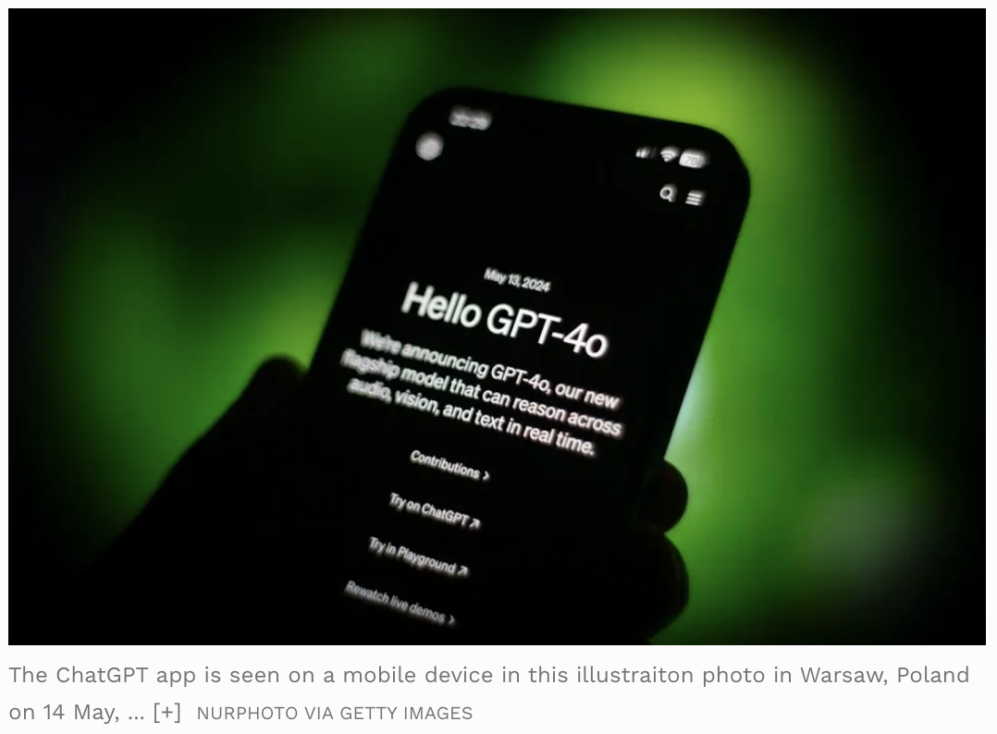
Notes:
ChatGPT has seen incredible progression over the last few months, let alone in the past few years.

Slide 4
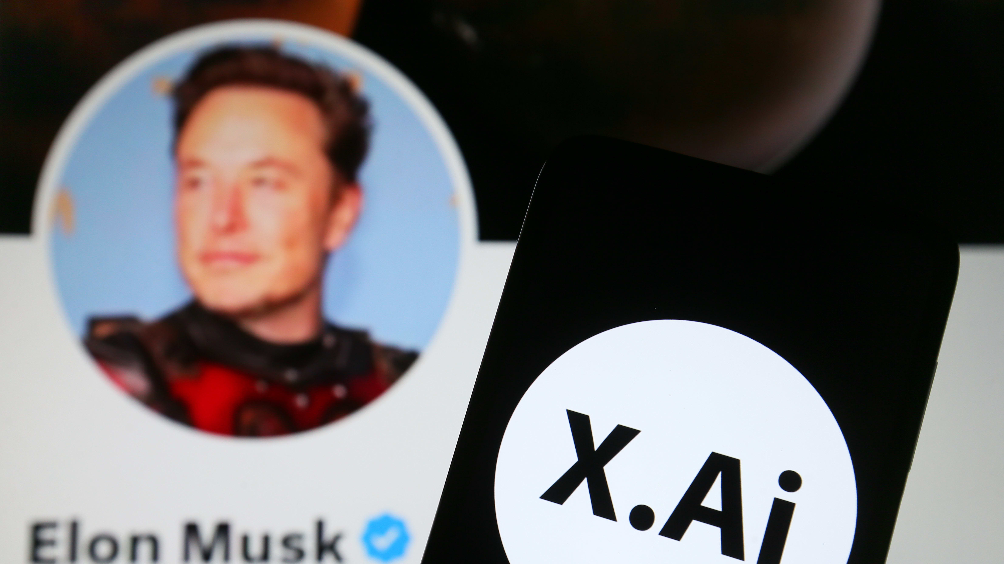
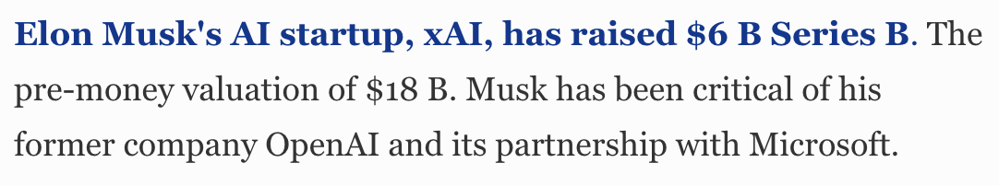
Notes:
Or how about when we see Elon Musk breaking records for his startup xAI,
attempting to be a rival to leaders in the tech and AI space, in seeding and valuation?

Slide 5

Fool Me Once?
Notes:
Nonetheless, we also see the rapid rise of AI-generated misinformation.
This part of a bigger picture, which I would like you to learn about today – Fake News, Deepfakes and Online Echo Chambers.
There are not just abstract concepts, but tangible issues that affect us all.

Slide 6
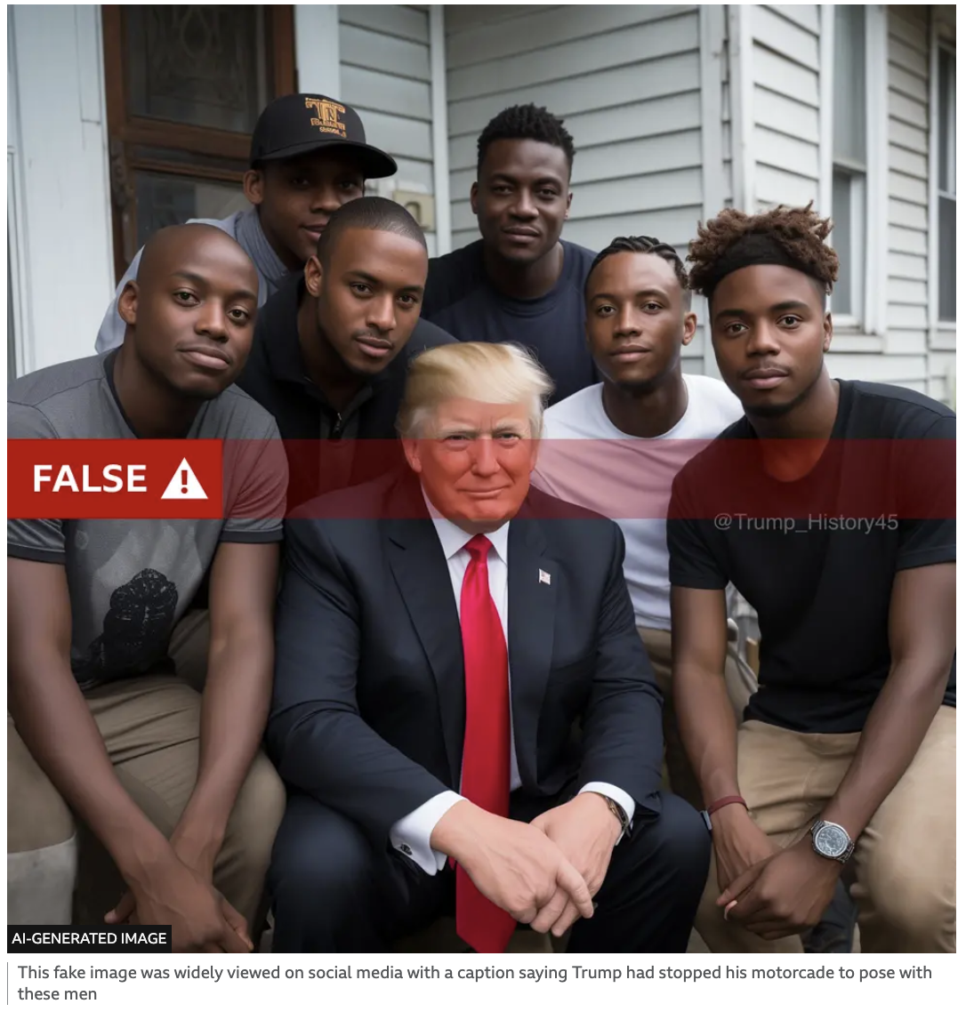
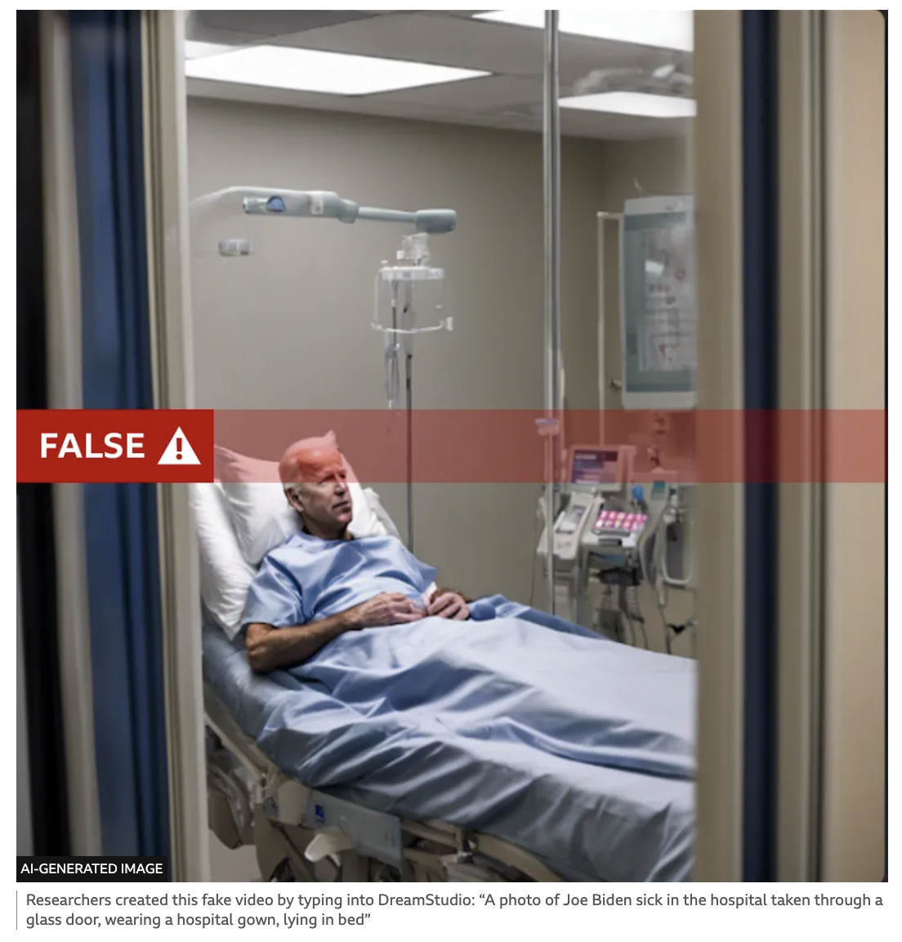
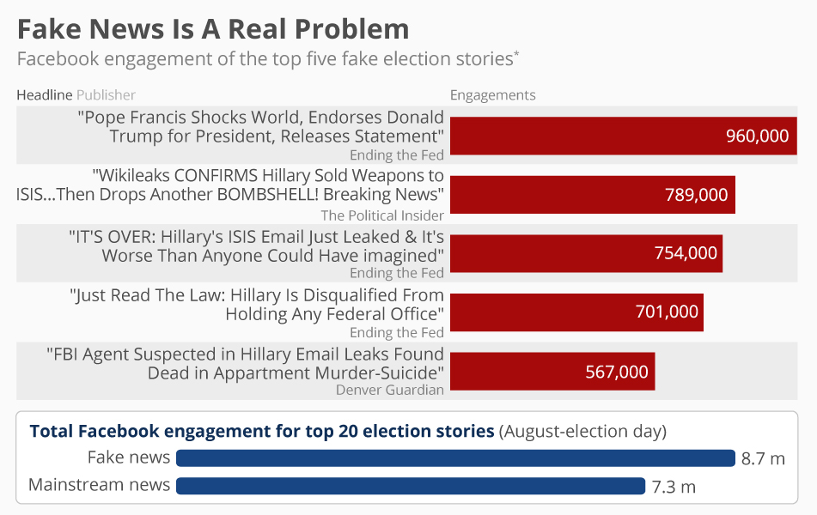
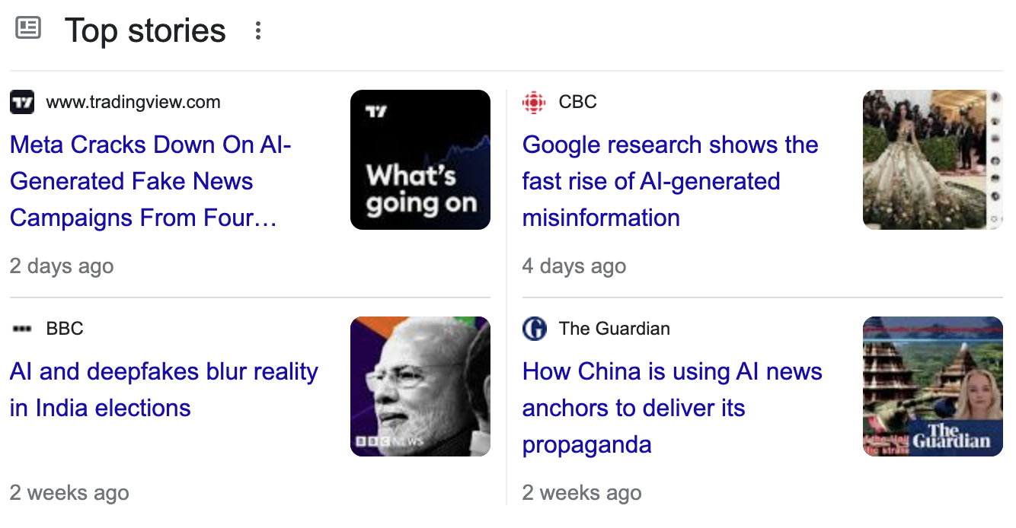
Notes:
Hands up if any of you have ever heard of the term “Fake News”.
AI can generate incredibly realistic yet entirely fabricated news articles and videos.
These are not merely amusing tricks; they can influence public opinion and potentially sway elections.
During the 2016 US elections, fake news articles outperformed genuine news on social media – should we not question whether this impacted voters’ opinions?
The difference is the technological landscape has evolved since 2016 - AI-generated news articles and videos can appear authentic but are entirely fabricated.

Slide 7
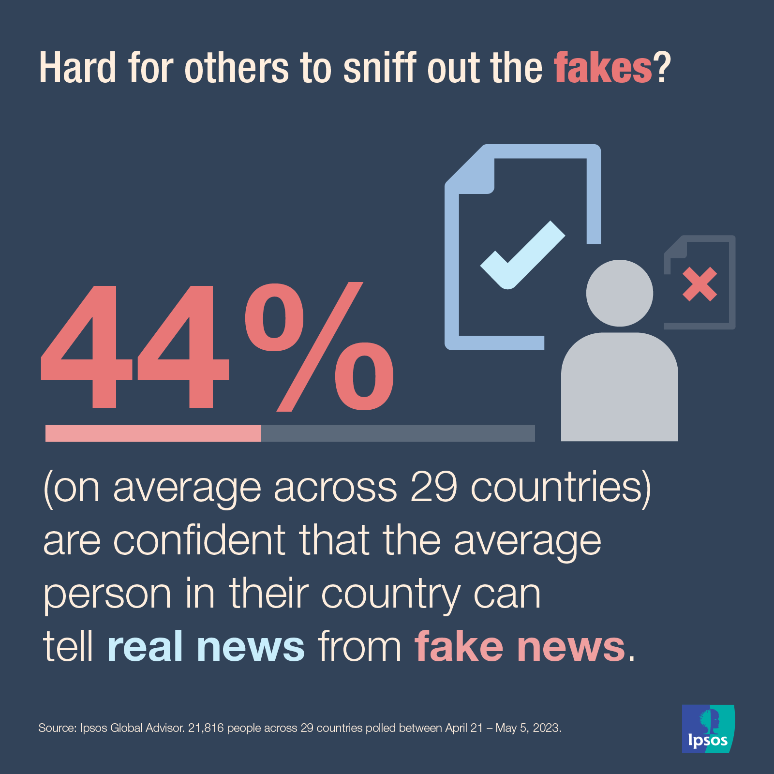
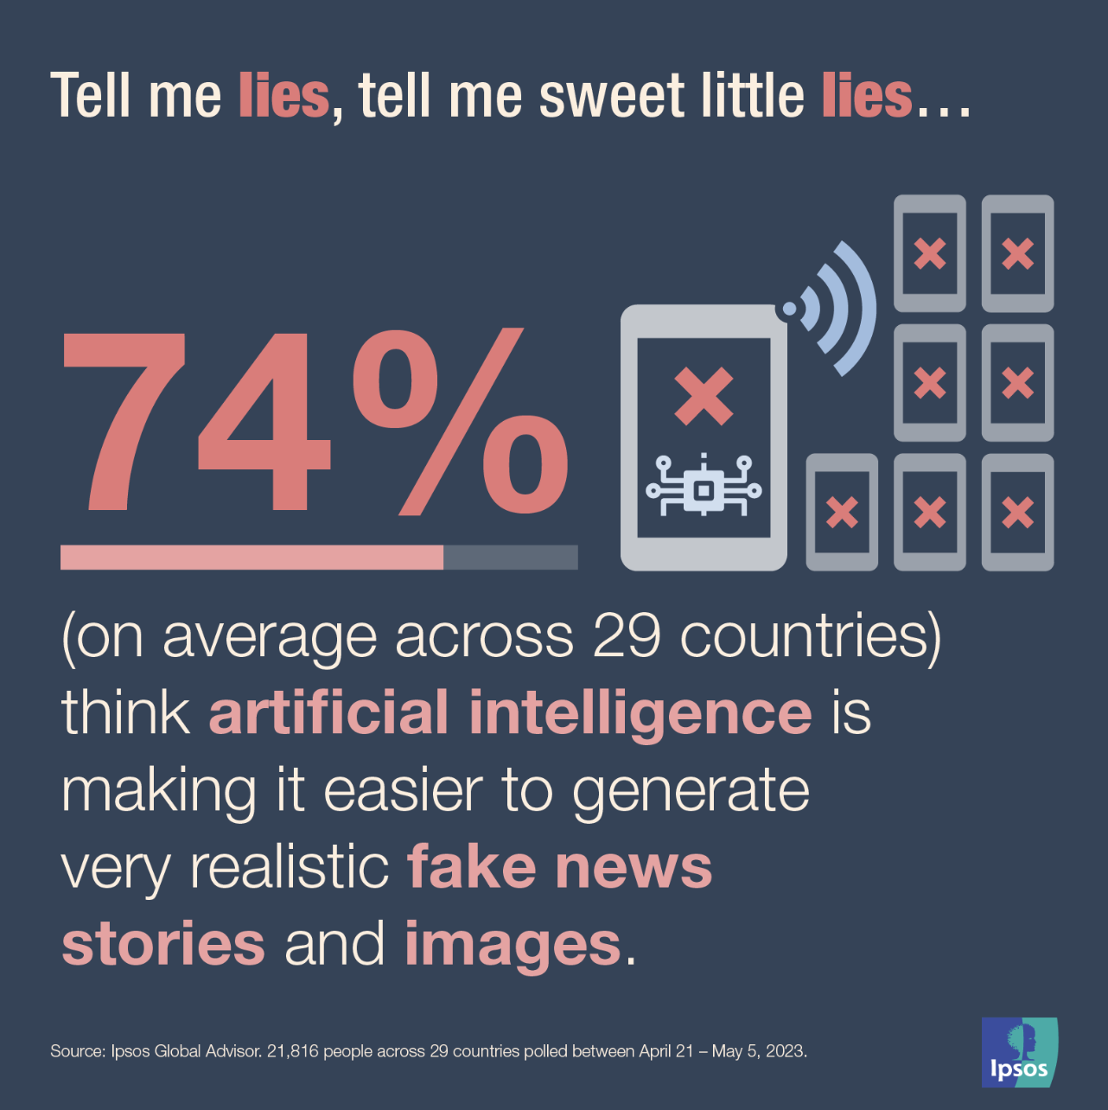
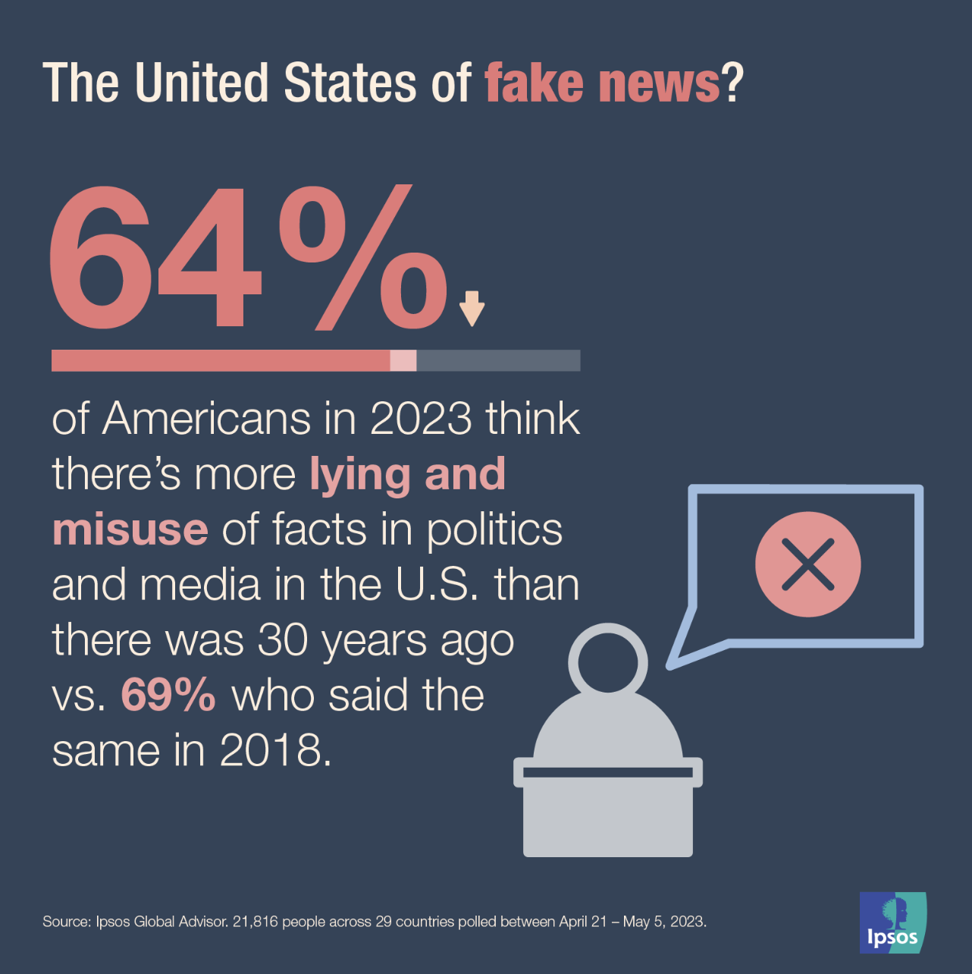
Notes:
AI uses sophisticated algorithms, like Natural Language Processing, to create convincing text,
and Generative Adversarial Networks, or GANs, to produce realistic images and videos (we will briefly take a look at how these work later).
Combined with data harvested from social media, these tools can target individuals with precision, manipulating their views without their consent.
This causes the erosion of public trust, and it becomes increasingly difficult to distinguish between true and false information.

Slide 8
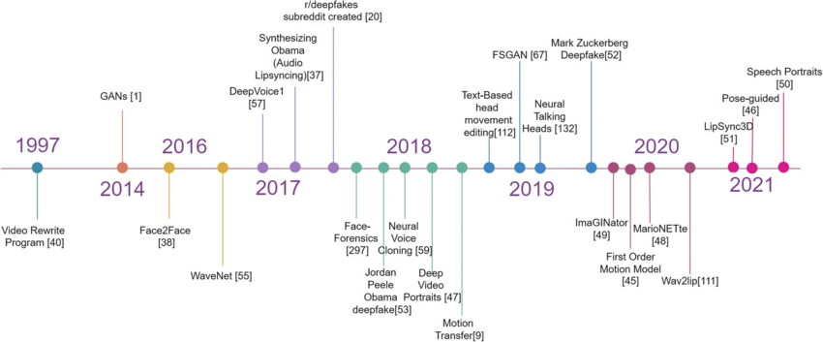
Notes:
Next, we have Deepfakes. Originally, these AI-generated synthetic media focused on explicit content.
However, their use has expanded to professional theft, social engineering, and even falsified religious verdicts (we will examine a few examples shortly).
It would not do it justice to summarise the timeline (point backwards) in the last few years, so let us take a look at some examples.

Slide 9
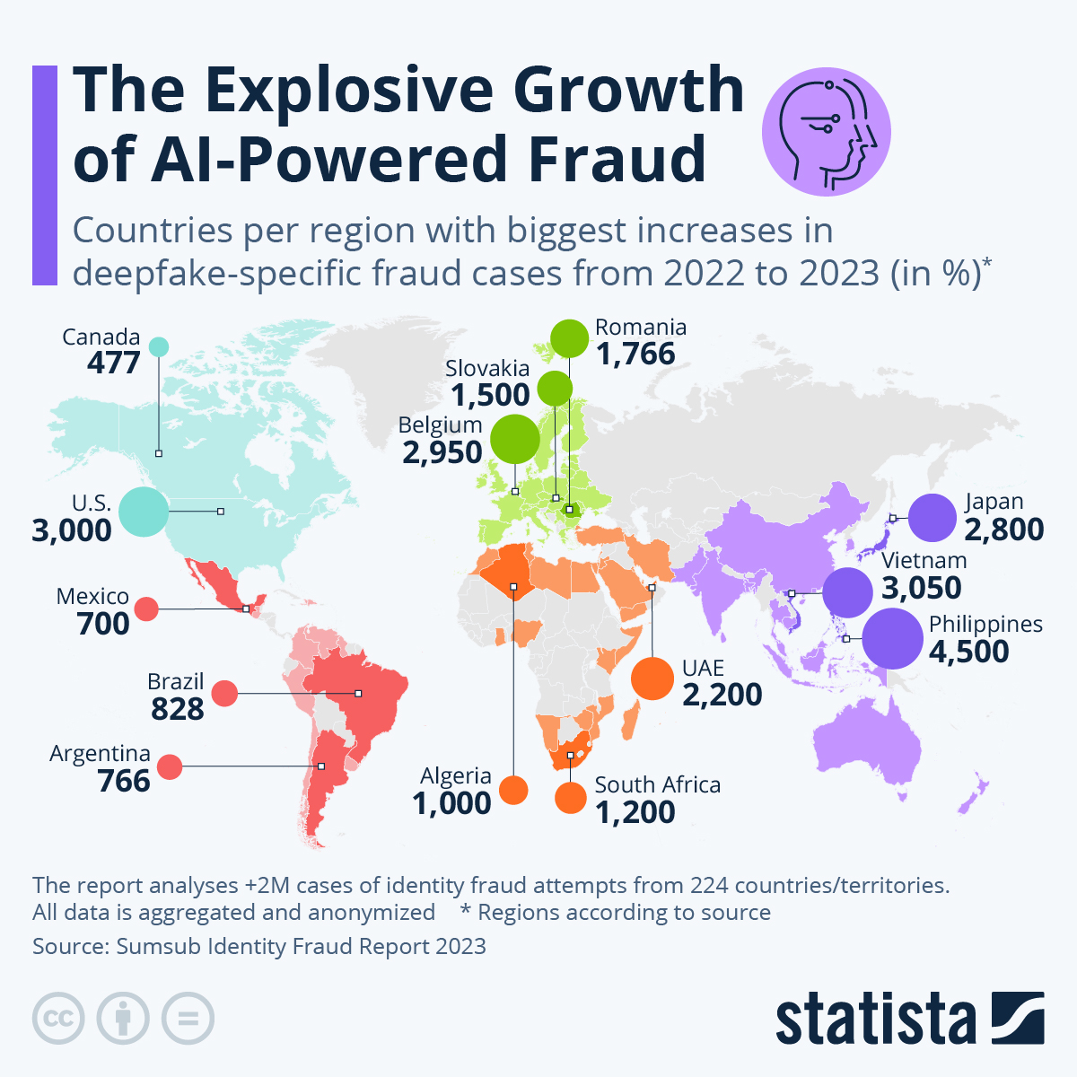
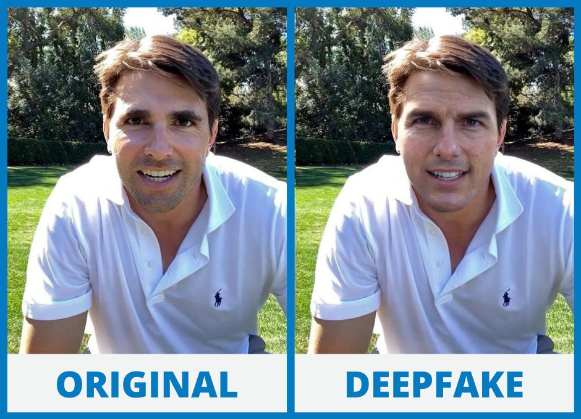
Notes:
Deepfakes do not only apply just to images.
We saw examples of Presidents Trump and Biden (Allahu Yahdeehim) earlier.
They also apply to audios through AI voice cloning.

Slide 10
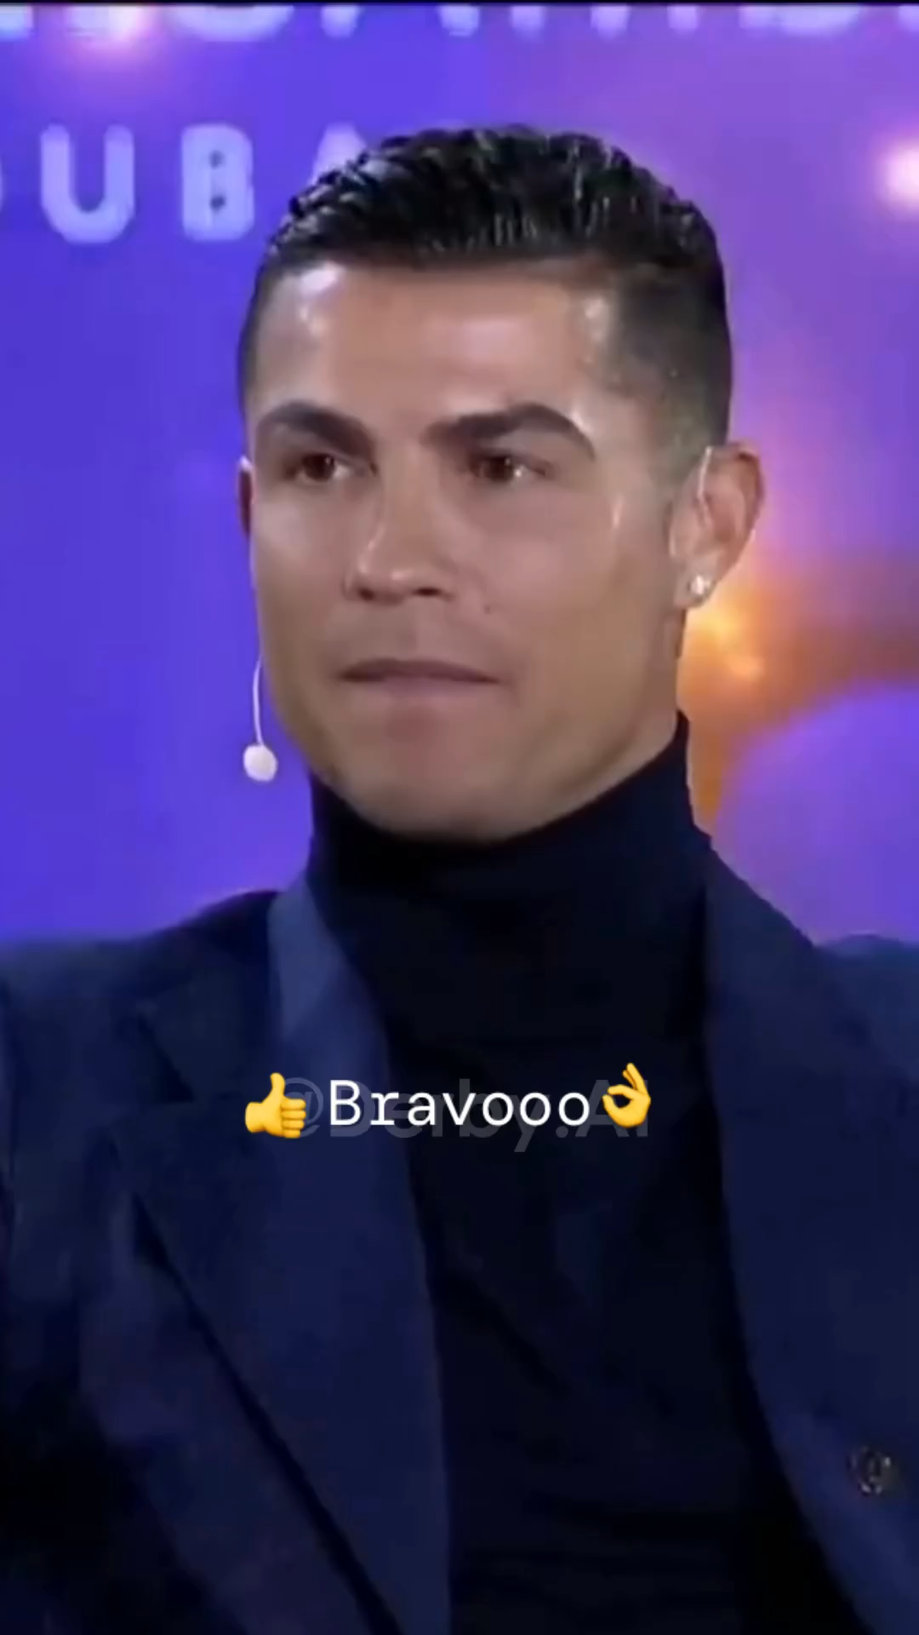

Slide 11
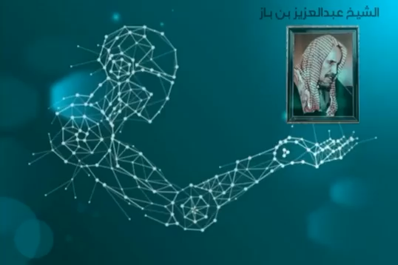
Notes:
AI can be used to mimic the voice of anyone.
Here is an example of AI mimicking the voice of Shaikh ʿAbdul-ʿAzeez Ibn Bāz رحمه الله from September 2023.

Slide 12
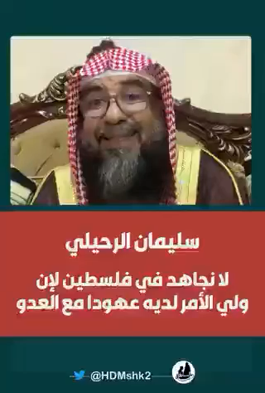
Notes:
This is from April 2024, just 7 months later.

Slide 13
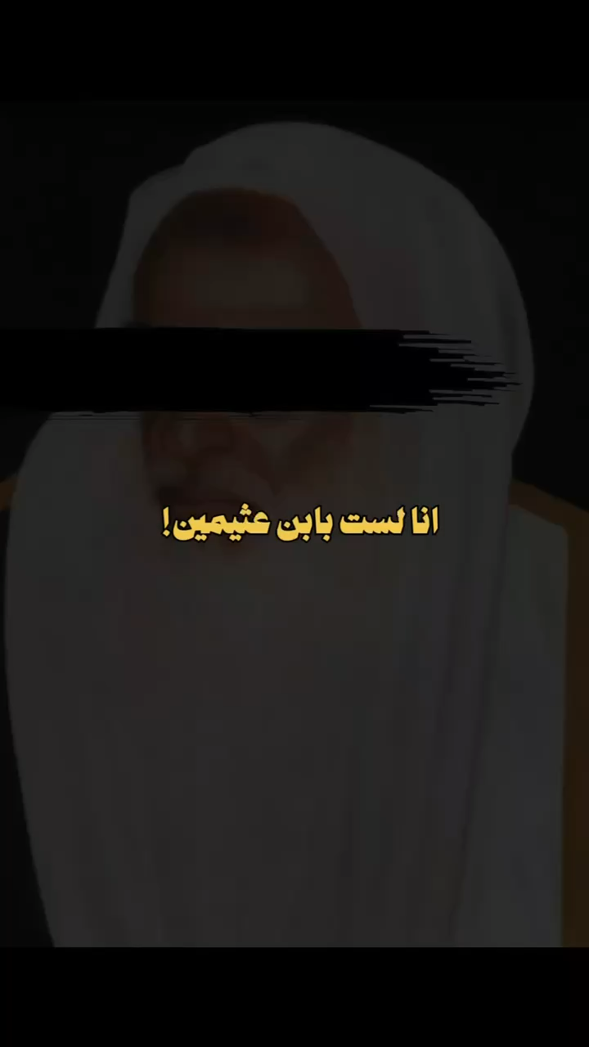
Notes:
Here are two other audios of Shaykh Al-Uthaymeen and Al-Fawzaan with the same speech, from May 2024, a month after the last.

Slide 14
Imām al-Awzāʿee (died 157 AH) said: “We would hear a hadeeth and then present it to our scholars just as one presents a counterfeit coin (dirham) to a teller—so what they accepted, we accepted and what they rejected, we rejected.” (See al-Jarh wat-Taʿdeel, 2/21)
Know that liars and imposters appeared early on in the Ummah. Abu Hātim ibn Hibbān, the great scholar of hadeeth (d. 354 AH) said in his Kitāb Al-Majrooheen minal-Muhadditheen (The Book of the Abandoned Ones from the Narrators of Hadeeth): “I heard Abdullāh ibn ʿAli Al-Jabuli say: I heard Abdullah ibn Yazeed Al-Muqree say: ‘A man from Ahlul-Bidʿah who recanted from his innovation said: ‘Investigate from whom you take the hadeeth, for indeed if we took an opinion, we would invent a hadeeth to support it.’”
Muhammad Ibn Seereen (d. 110 AH) mentioned the importance of sourcing the narrations. He said: “…but when the conflict and discord occurred, they (Ahlus-Sunnah) would ask: ‘Name to us your men’. So Ahl us-Sunnah would be considered and their narrations accepted—and Ahlul-Biʿdah would be considered and their narrations not accepted.” (Saheeh Muslim, Al-Muqaddimah: 27)
Furthermore, ʿAbdullāh Ibn Mubārak (d. 181 AH) said: “The isnād (chain of narration) is from the Religion—were it not for the isnād, anyone could say whatever he wanted to say.” (Saheeh Muslim, Al-Muqaddimah: 32)
Notes:
So beware of strange audio Fatawa attributed to the senior scholars.
Fabricating hadeeth of the Prophet (peace and blessings be upon him) and the narrations of the Salaf is not of course a new phenomenon,
neither is ascribing statements to the scholars that they never uttered.
Today, however, the technology allows for more sophisticated methods of lying and deception.
For those who are non-Muslim and from the West, we are more than accustomed to hearing the words Fake News and more recently, AI generated media.
But I wanted to show how it can affect everyone, even in this country – with some of its biggest scholars.
To give some context, the scholar in the first clip, was the former Grand Mufti in Saudia Arabia.
More than a million people attended his funeral in Makkah.
The influence that these men possess is immense.
We should only take from known and trusted channels and websites.
Would one take a risk when it comes to a medical treatment?
Believing that some drug can cure your illness – without any proof or verification?
Then what about our religion?
By taking this approach, we are actually going back to the original methodology of verification
through chains of transmission as close as possible to the source.
The narrations of people would not be accepted except after knowing them, and knowing their isnād (i.e. chain of narration)
so, let us return back to the methodology of the Salaf As-Salih.
Today’s equivalent in the world of social media and the internet would be to follow and take from known scholars, shaikhs, students of knowledge and duʿāt
whose integrity, trustworthiness, truthfulness, adherence to the Sunnah and the Manhaj of the Salaf is established through recommendations.
And when it comes to the dunya, the worldy life, and this is advice which applies to the non-Muslims with us too –
verify the information that comes to you. We’ve all heard about mind control - do not let AI algorithms dictate your thoughts nor opinions.
And this is the beauty of our religion – focusing on the science of narrations and trustworthiness (as is well known in the study of ilm ul-rijaal).

Slide 15
How do we avoid this?
1. Refer to their books and documented Fatawa
2. Use their official websites
3. Verify anything which opposes their known positions
4. Ask their reliable students, if possible
5. Rely on credible sites and be cautious with unknown or unverified sites and clips
Notes:
This leaves the question, how do we avoid this?
What you can do is…
1. Refer to the books of the Scholars and students of knowledge and documented Fatawa
2. Use their official websites
3. Verify anything strange and odd, which opposes their known positions
4. Ask their reliable students, if possible
5. Rely on credible sites and be cautious with unknown or unverified sites and clips
Our Shaykh, Imam Muqbil رحمه الله used to say: “The people of falsehood can only resort to lies.”
I’d actually like to interject here and promote my own course, Cryptography and Cybersecurity.
See, if we resort to only a few sources, we narrow down the focus for attackers and hackers.
If they are successful, what will we have left?

Slide 16
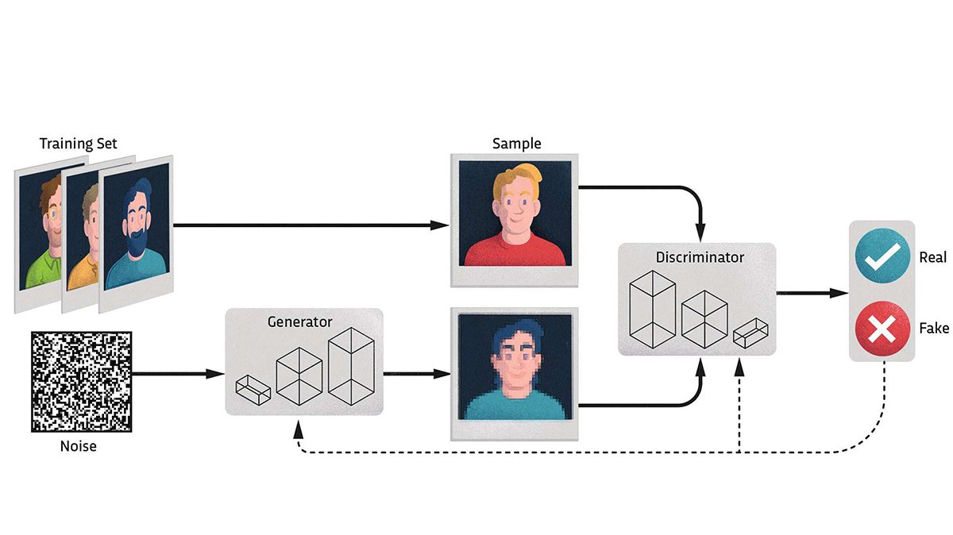
Notes:
Now let’s take a brief look at some of the technology behind this.
Deepfakes rely on GANs to swap faces in videos, making it hard to distinguish real from fake.
The threat is significant: from identity theft to financial fraud,
and from manipulating public figures to spreading false information.
AI tools are being developed to detect deepfakes,
but the technology is evolving rapidly, making it a constant battle.
What you are seeing here is a brief overview of how a GAN works.
We have a training set,
which is basically just a bunch of real images
(we would consider this a high dimensional latent space).
Then we have some noise (just randomness in an image, which we would consider low dimensional latent space).
A GAN is an adversarial network – meaning it involves two components which battle against each other.
The generator attempts to take this noise, and make realistic images.
The discriminator tries to determine whether or not the image its given is real or fake.
Over time, the discriminator gets better at choosing between real and fake images.
This information is given to the generator which gets better at producing more and more realistic images.
This feedback loop constantly improves both of these models,
and thus we end up with a model that can be used to create fake images.
With a little bit of tuning and expertise, we can start to produce all sorts of fake images and audios.

Slide 17
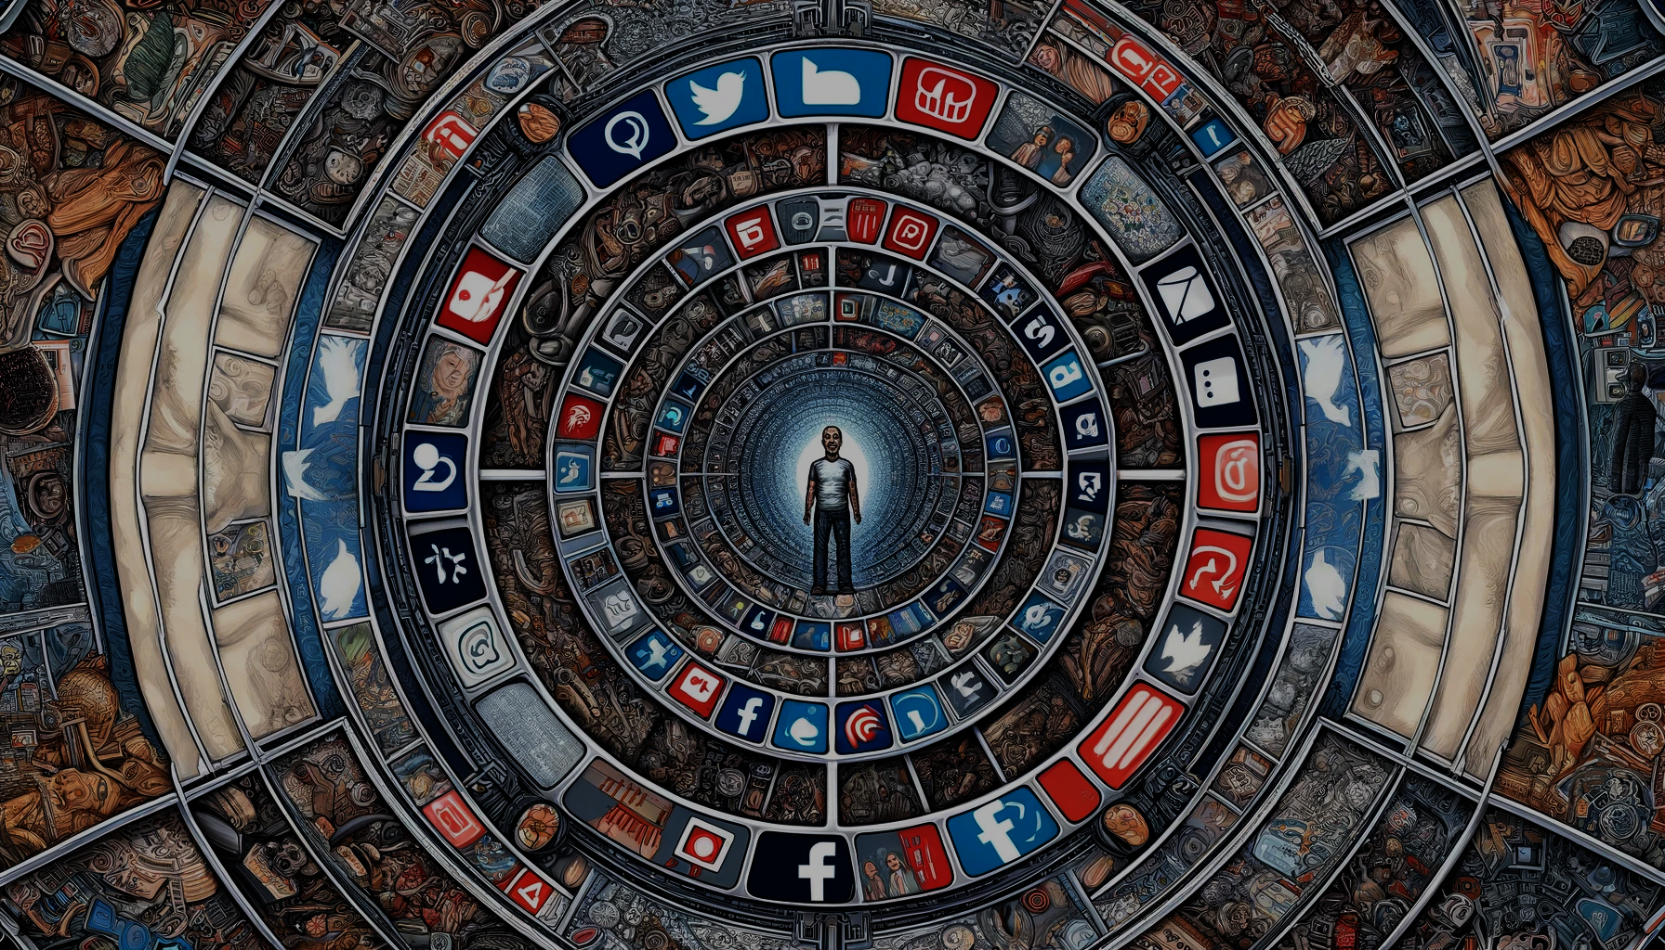
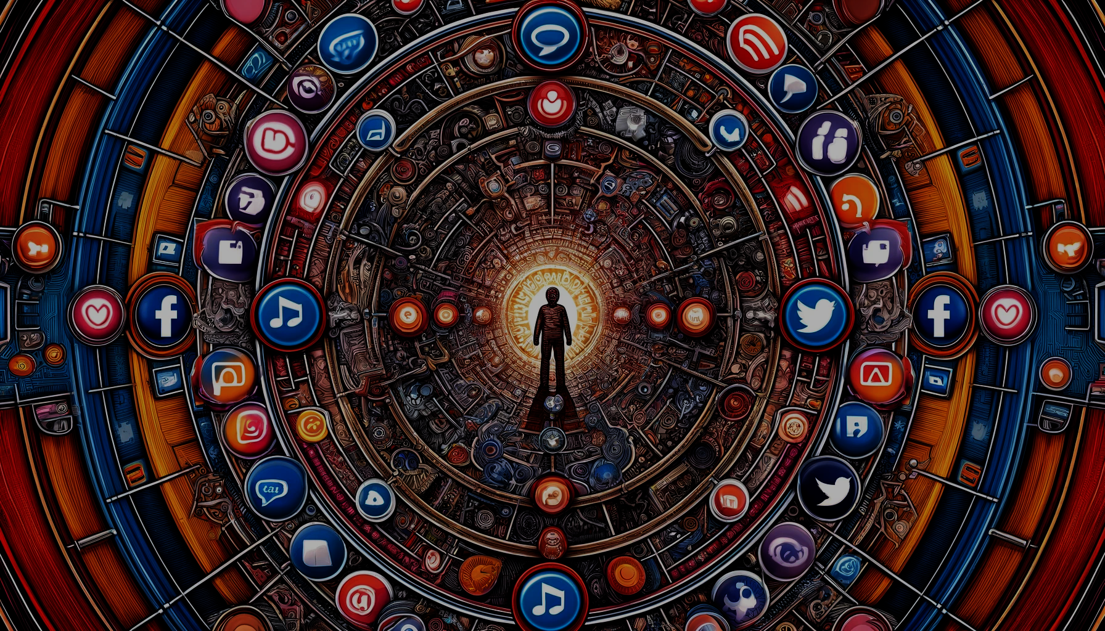
Echo Chambers
Notes:
Finally, let’s talk about the Social Media and online platform Echo Chambers.
AI-driven algorithms on social media platforms curate personalised content, reinforcing users' existing beliefs.
This can lead to polarisation, as people are less exposed to diverse viewpoints.
What ends up happening is most people do not post anything.
It is the extreme minority which do.
And this minority are at such extremes of all spectrums, that is what you and I think the world is like.
But when you go out and actually meet real people, you realise just how wrong your perception was and how toxic these places can be.

Slide 18
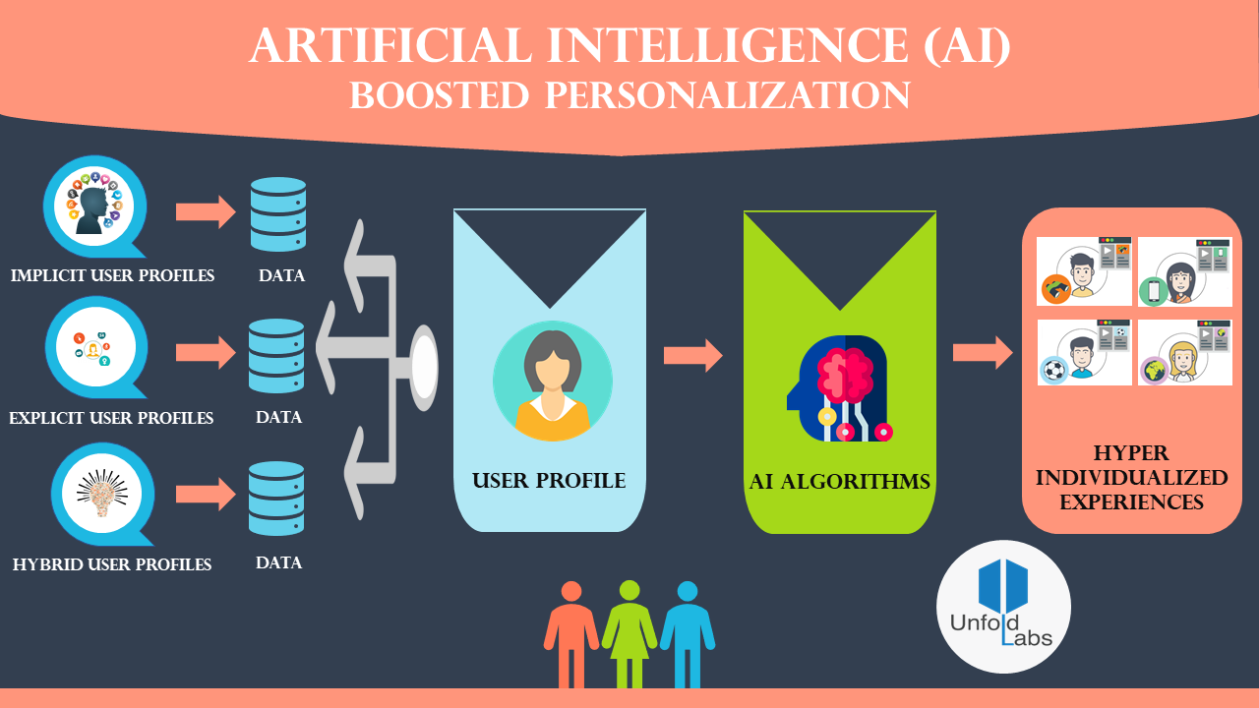
Notes:
These algorithms prioritise engagement, showing users content that keeps them on the platform longer.
This often means more sensational, polarising content.
The result?
Communities become more divided, and misinformation spreads more easily.
These hyper individualised experiences are what cause you to feel so much strong emotions online,
and are reasons for you to doomscroll on TikTok, Instagram Reels or YouTube Shorts.
Whilst we can propose a solution in promoting diverse content and raising awareness about the impact of echo chambers –
the most important thing is what each and every one of us can do individually.

Slide 19
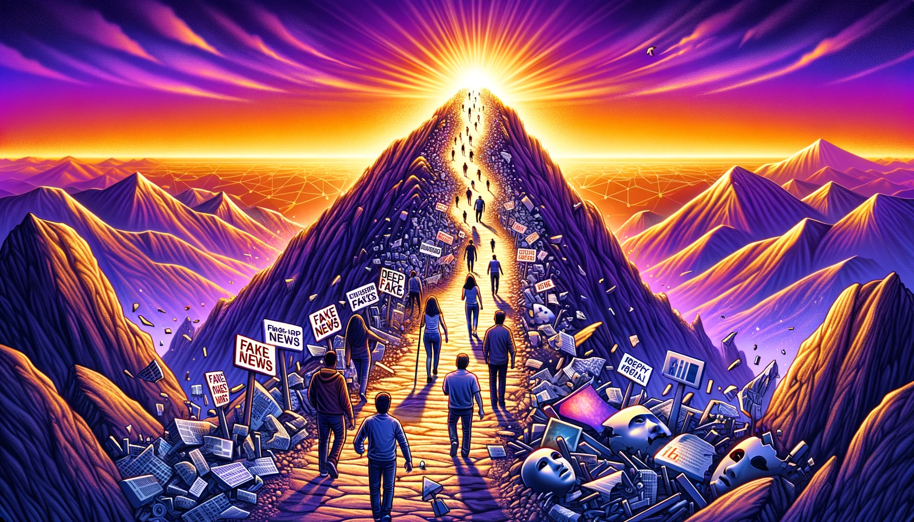
Notes:
Here is the simplest conclusion I can give.
There is an evolving threat of fake news and deepfakes.
Social media is taking up more and more of your time and thoughts.
AI will continue to accelerate this process.
So, prepare yourselves for the upcoming era of misinformation
by focusing on the importance of critical thinking, media literacy, and technical literacy.

Slide 20
A New Age of Fabrication
Omar Choudhry (O.Choudhry@leeds.ac.uk)
Oxmedica-Mawhiba Summer Tech Summit 2024
Notes:
Thank you for your attention, جزاك الله خيرا .
I’d now like to open the floor for questions. If you have any further inquiries or wish to discuss these topics more in-depth, feel free to reach out to me via email.

